Slide 1
The effect of SNAP and food retailers
Subtitle

Slide 2
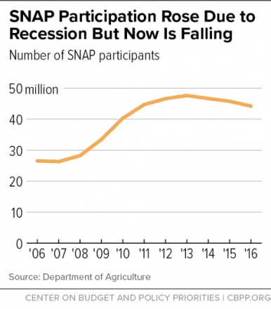
What is the Supplemental Nutrition Assistance Program (SNAP)?
Its basically food stamps under a different name.
Offers nutrition assistance to millions of low-income individuals and families and provides economic benefits to communities.
The largest program in the domestic hunger safety net.
Close to 70 percent of SNAP participants are in families with children
More than one-quarter are in households with seniors or people with disabilities.
In 2016, the federal government spent about $73 billion on SNAP.
93% of it on food
The number of SNAP participants has been decreasing.

Slide 3
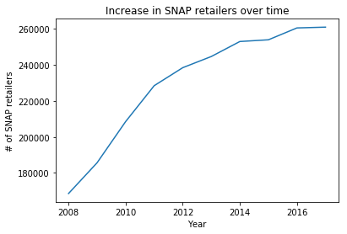
What kinds of stores can be SNAP retailers?
SNAP authorized stores must meet one of two staple food requirements:
staple food inventory
staple food sales
Staple food inventory requires a store to stock, on a continuous basis, a certain variety and quantity of staple foods, including some perishable staple foods.
Most stores are authorized under Criterion A.
Staple food sales requires a store to have more than 50 percent of its total gross retail food sales from the sale of staple foods.
Specialty stores, like butcher shops, bakeries, etc.
The number of SNAP retailers has been rising.

Slide 4

How does SNAP affect small businesses?
Why is the number of SNAP retailers increasing but the number of SNAP recipients decreasing?
Most likely has something to do with the benefits they receive from participating
How much of there profit small businesses are making from SNAP participants?
Are convenience stores reliant of SNAP participents?
What kinds of stores are prone to be SNAP retailers?
How does that affect the food SNAP participants reccieve?

Slide 5
The Data
A csv file
425885 rows x 21 columns
Goal: to find duplicate stores
Same Store
Different

Slide 6

What is Pandas?
Data Analysis library
a Python package providing fast, flexible, and expressive data structures designed to make working with data both easy and intuitive.
Closely integrated with NumPy and Matplotlib
Pandas DataFrames
can be thought of either as a generalization of a NumPy array
a 2-dimensional labeled data structure with columns of potentially different types.

Slide 7
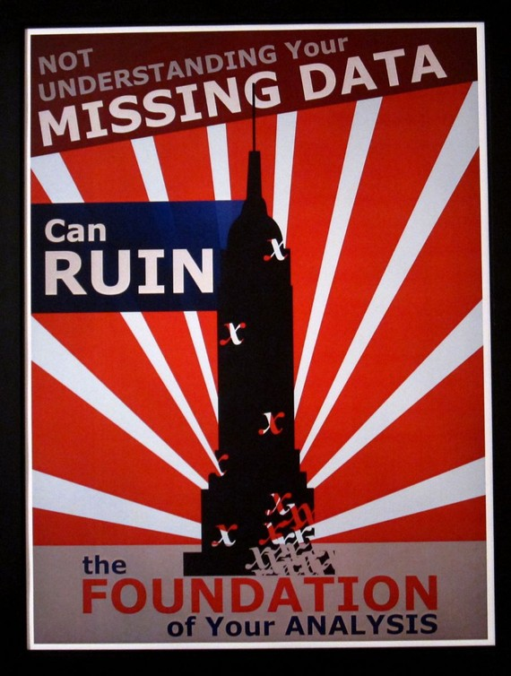
Handling missing data with Pandas and NumPy
A lot of missing data in the file
Pandas has a wide range of ways you can deal with missing data
Generally involves using masks or choosing sentinel values
Sperate Boolean array representing the null state of a value
Sentinel value would be a value you set as a benchmark for what is null
Simple fast way to quickly identify and find out how much missing data you have
Easy ways to drop and then fill missing data

Slide 8

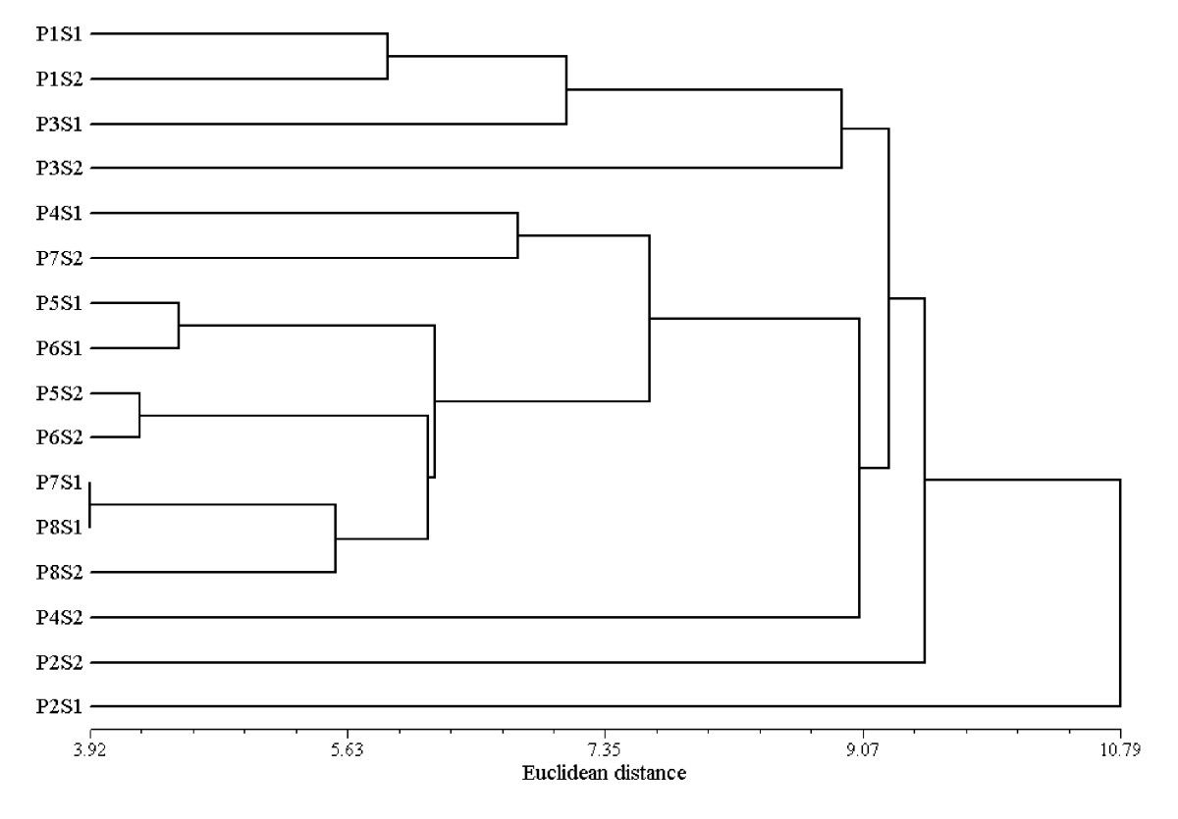
Finding the Duplicates
Pandas there is a .duplicated() method
Return boolean Series denoting duplicate rows
One column at a time
Simple methods for finding duplicates
Match store names with zip codes
Searching for duplicate names
False Positives – are likely going to occur
Geocoding comparison
Hierarchical Clustering
Allows for unknown number of clusters

Slide 9
Looking to the Future
Are there any underlying patterns where missing data occurs?
How are false positives and false negatives going to affect our duplicate finding process?
Will running through multiple trials of different processes help or just add more uncertainty?
What other methods can we use to find duplicates more effectively?

